Slide 1
Priority Queue & Binary Heap
CS-2001 Data Structures

Slide 2
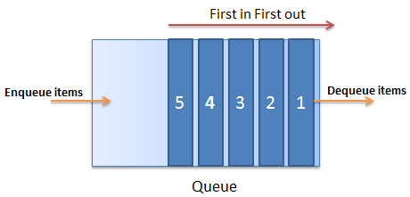
Queue vs Priority Queue
Recall that the Queue data structure follows fair policy for insertion and removal i.e. First In First Out (FIFO)

Slide 3
Queue vs Priority Queue
What if some elements of different priorities?
What if the highest (or lowest) priority needs to be removed from the queue instead of the element that was inserted first?
We need a priority based (yet unfair) policy for queues!!!

Slide 4
Priority Queue
A priority queue is a special type of queue in which each element is associated with a priority and is served/read/removed/outputted according to its priority
If elements with the same priority occur, they are served according to their order in the queue

Slide 5
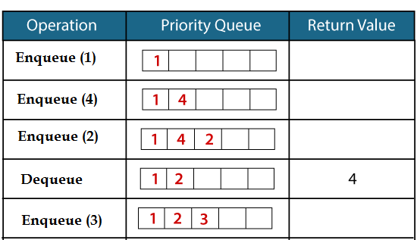
Example: Priority Queue

Slide 6
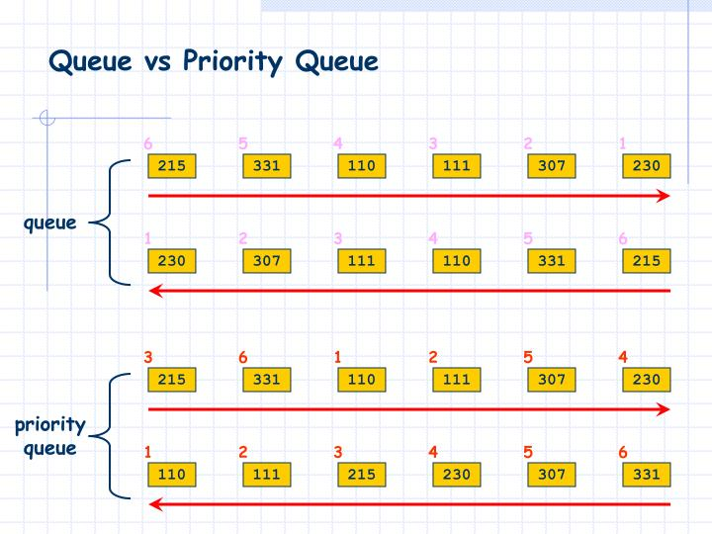

Slide 7
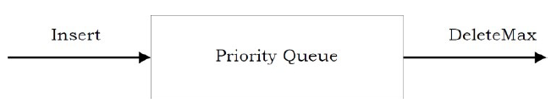
Example: Max Priority Queue

Slide 8
Operations
Primary operations
Enqueue: Inserting a new element
DeleteMin/DeleteMax: Performing deletion (dequeue) based on priority
GetMin/GetMax: Read min or max priority value without deleting it
Secondary operations
k^{th} smallest / k^{th} largest element
Size: Returning size of queue

Slide 9
Applications
Minimum spanning tree
Shortest path algorithms
Operating System scheduling algorithms
Real-time customer care
... and many more

Slide 10
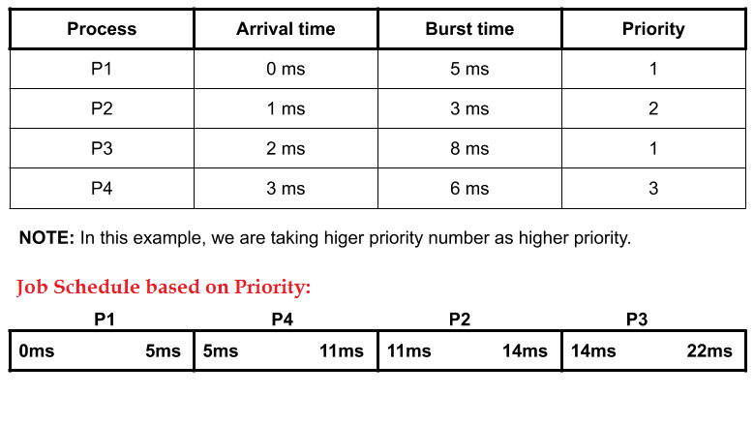
Application: OS Scheduling Algorithm

Slide 11
Implementation
Using arrays (shadow array)
Using Linked List
Using Heap

Slide 12
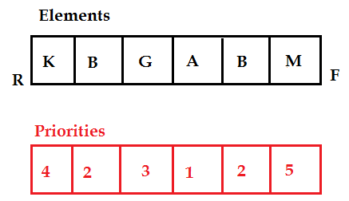
Naïve Array Implementation
Maintain another array of
priorities
Each element in shadow
array represents priority
at corresponding index of
queue

Slide 13
Naïve Array Implementation
Enqueue is same as in queue
For dequeue a single
pass (O(n)) is made over
shadow array and index
of highest value is recorded
Element at that index is then DeQueued

Slide 14
Binary Heap
A Binary Heap is a data structure which has the following properties:
It is a complete binary tree
For any given node, its value must be ≥ (or ≤) than the values of its children
This is called Heap Property

Slide 15
Types of Heap
There are two types of Heaps:
Max Heap : The value of a node must be greater than or equal to the values of its children
Min Heap : The value of a node must be less than or equal to the values of its children

Slide 16
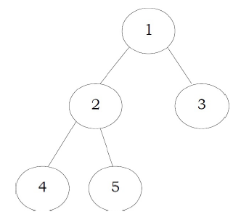
Example (Min Heap)

Slide 17
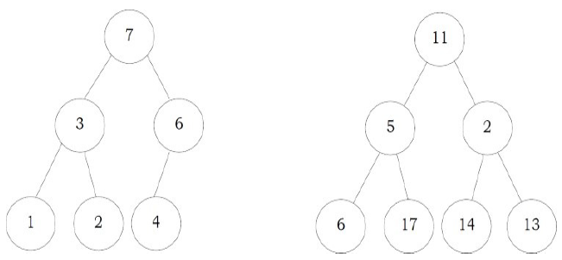
Which of these is a Max Heap?

Slide 18
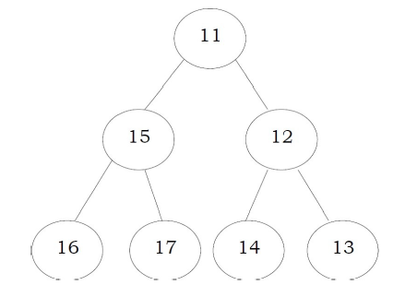
Is this a Max or Min Heap?

Slide 19
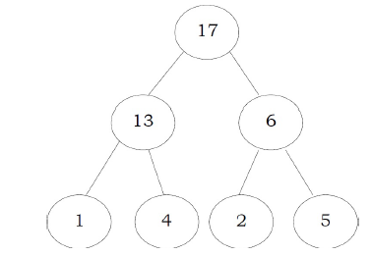

Priority Queue using Heap

Slide 20
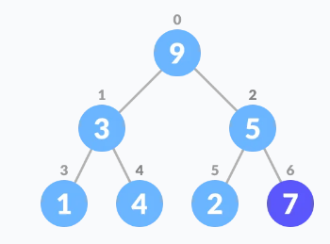
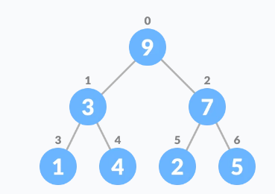
Insertion in Priority Queue
Insert new element
Heapify

Slide 21
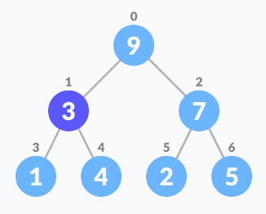
Deletion in Priority Queue
Select the element to be deleted

Slide 22
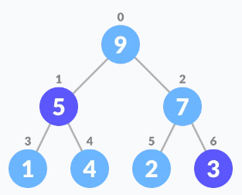
Deletion (cont.)
Swap it with the last element

Slide 23
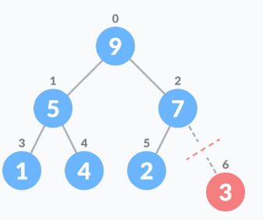
Deletion (cont.)
Remove the last element

Slide 24
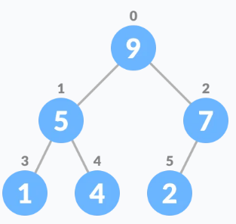
Deletion (cont.)
Heapify

Slide 25
Summary
A Min Heap or Max Heap is a useful data structure that has applications in priority-centered problems
It can also be used in sorting the elements of a given array (i.e. Heap Sort algorithm)

